Slide 1
Business Intelligence Part 1: Multidimensional Analysis
Sources of material:
Slideshare (michal lamont, Harvard university)

Slide 2
Learning Objectives
Define multidimensional analysis (MDA)
Explain the terminology associated with MDA
Explain the common operations performed in MDA
Illustrate how MDA is implemented in Excel using Pivot tables/Pivot charts

Slide 3
What is Multidimensional Analysis?
Multi-Dimensional Analysis is data Analysis which takes into account many different relationships, each of which represents a dimension.
Example
Relationships among sales by region, by quarter, by product

Slide 4
Multidimensional Analysis
Terminology
Dimension: categorically consistent view of data
Two test of dimensionality:
1. Can data about members be compared?
E.g., sales numbers of one product compared to sales numbers of another product.
2. Can data from members be aggregated into summaries?
E.g., Jan, Feb, and Mar aggregate together as Q1.

Slide 5
Multidimensional Analysis
Terminology contd.
Dimension Title: name/identifier used to make the dimension known (e.g., region, product, time)
Dimension member: an element of a given dimension (e.g., year, quarter, month, and week are members of the “time” dimension)

Slide 6
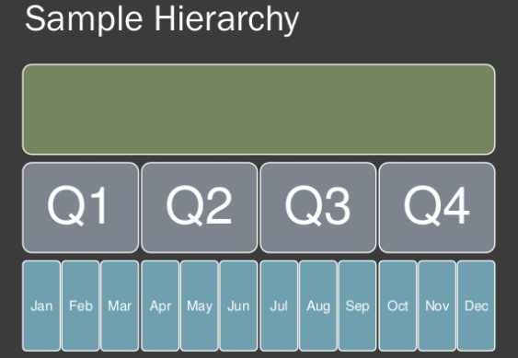
Multidimensional Analysis
Terminology contd.
Dimension hierarchy: way to organize dimension members into parent-child relationships (i.e., into levels).
Year

Slide 7
Multidimensional Analysis
Terminology contd.
Measure: data being analyzed across multiple dimensions (e.g., dollar sales of soda by month, by product, by city).
Four important properties of a measure:
Always a quantity or an expression that yields a quantity
Can take any quantitative format (e.g., count, sum, average, etc)
Can be derived from original data source of calculation
At least one measure is required to perform MDA

Slide 8
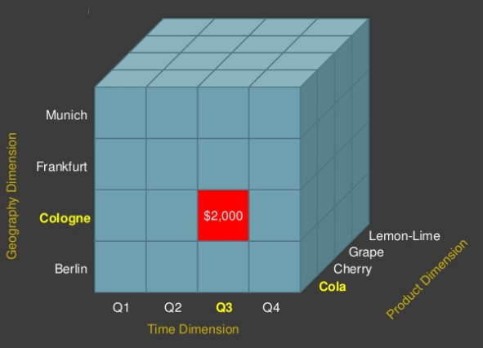
Multidimensional Analysis
Data point: intersection of multiple dimensions
Data value: the actual value found at the data point.
The highlighted data point shows the intersection of geography, time, and product dimensions, giving a data value of $2,000.
What does it mean?

Slide 9
Multidimensional Analysis Operations
Slicing and Dicing
Dimensions let you
slice and dice multidimensional data
Slice: a subset of a multidimensional array
Dice: a slice on more than two dimensions

Slide 10
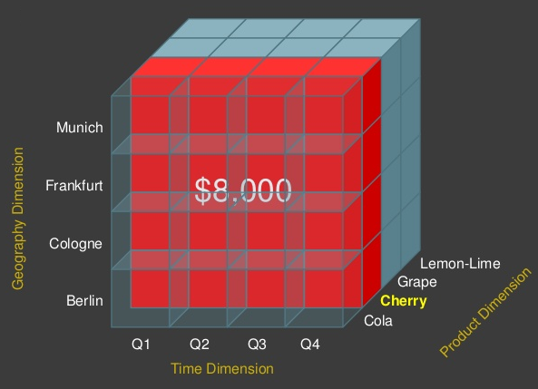
Multidimensional Analysis Operations
What question is the slicing operation on the right trying to answer?

Slide 11
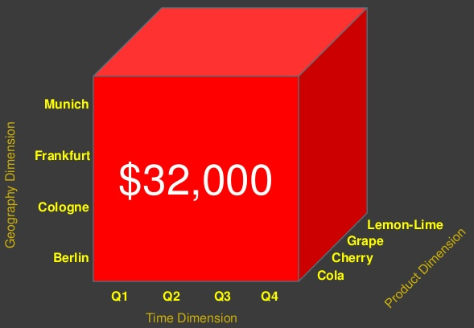
Multidimensional Analysis Operations
Drill Down/Up - navigating among levels of data ranging from the most summarized (up) to the most detailed (down)
Roll Up - computing all of the data relationships for one or more dimensions
Pivot - used to change the dimensional orientation of a report or an ad hoc query-page display
Roll up operation

Slide 12
Multidimensional Analysis Approaches
1. Pivot Tables/Pivot Charts
Can be implemented using Excel
Can incorporate slicers and timelines to facilitate ad hoc analysis
Focus of this course
2. Online Analytical Processing (OLAP)
Database-based
Often requires the use of a data warehouse or a data mart as a data source
Beyond the scope of this course

Slide 13
Summary
Multidimensional analysis technique helps us to analyze data that is represented in more than one dimension.
By using multidimensional analysis operations such as slice/dice and dill-down/roll-up, we can quickly summarize multidimensional data.
In practice, multidimensional analysis can be implemented either by means of Pivot tables/Pivot charts (e.g., using Excel) or online analytical processing (OLAP) using OLAP tools

